Slide 1


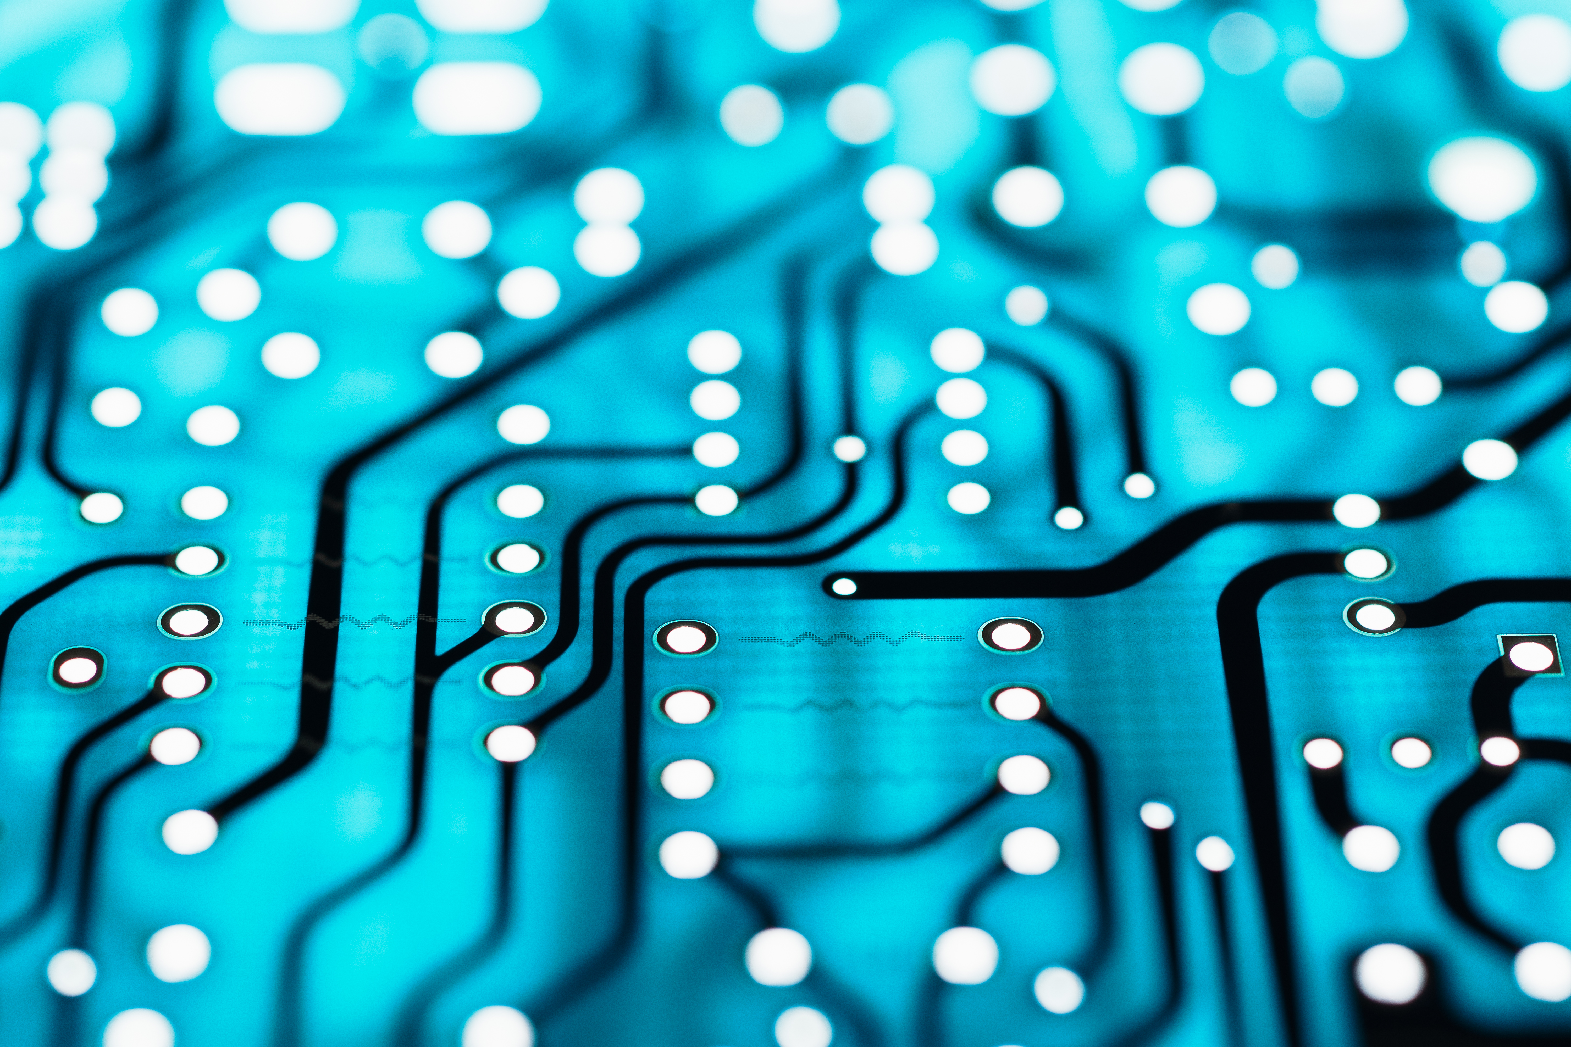
Byte sized tech
By Corey cRooks

Slide 2
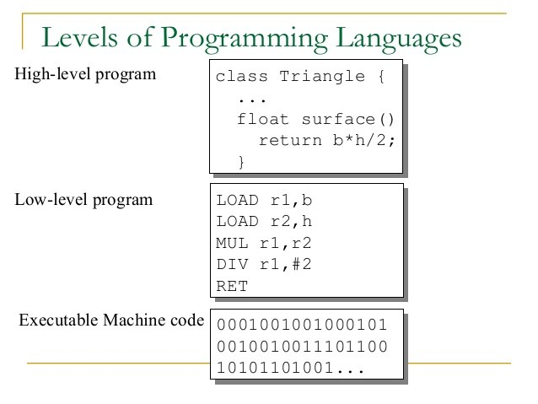
Binary Language
Computers understand either 1 or 0, but no words.
This is called “Machine Code”
All computers run off of this machine code.
Notes:
When you program a set of instructions using popular code languages like C++, JavaScript, or even Python, the compiler and linker will process your script and convert it into Assembly (also known as Machine Code), then to Binary. Each 1 represents a bit that is ‘on’ and each 0 represents a bit that is ‘off’. This will help the computer process your instructions, and perform actions based off of what you tell it to do.
The series of 1’s and 0’s is called machine code. This is because machines are incapable of operating off of just higher-level code by itself, and odds are that you won’t write billions of 1’s and 0’s in an exact sequence to write a multi-gigabyte program. For that you have human-readable code, or higher level code languages to help you take your ideas and put them into a form the computer will understand.
To date, there is no computer that can take a higher level language and operate off of that alone. It will always need a compiler and linker to turn your script into bits for it to read.
https://www.computerhope.com/jargon/b/binary.htm
https://whatis.techtarget.com/definition/machine-code-machine-language

Slide 3
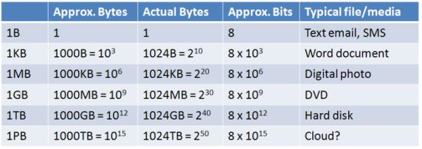
Bytes
Bytes (B)
KiloBytes (KB)
MegaBytes (MB)
Gigabytes (GB)
TeraBytes (TB)
PetaBytes (PB)
Notes:
Firstly, there are two different common measurements in computer terms. Bits and Bytes. Bits are always an eighth the size of their Byte counterpart (An eighth of a byte is a bit. An eight of a petabyte is a petabit). Bits are signified with a lower case B when shortened, while Bytes are a capitalized B. a MB is a megabyte whereas a Mb is a megabit. You can see this commonly used in network readings. When downloading a large file such as a game on Steam, your download will commonly be registered as XMB/s. This is X Megabytes per second. However, if you go to test your speed with a website like Ookla, or go to Comcast’s webpage and browse internet packages, you will commonly see it registered as “up to X Mbps” or “up to X Mb/s”. This is advertising speeds of up to x Megabits per second. Some customers would be frustrated by this, claiming that their download speed is 8 times slower in Steam than measured with Comcast. Now you know that isn’t the case, and It’s actually a different unit that you are seeing!
Now that we have that solved, let us talk about the types of the bytes. At the smallest, we have a simple bytes. These are useful to record character sizes or words. Next up we have KBs, or KiloBytes weighing in at one thousand bytes.. This can contain a whole host of words and can measure documents, letters, or emails. One thousand times that much is a MegaByte, or MB. This can measure images, short video clips, or fancy PowerPoints with imbedded graphics. One thousand MB’s would add up to a GigaByte, or GB. Here is when you get into the heavy hitters like Movies, or Videogames. One thousand times the size of a GigaByte is a TeraByte, or TB. This can contain and entire storage drive like an Hard Drive, or Solid State Drive. One thousand times that size will give you a PetaByte, or PB. This is very uncommon these days, as we don’t have much need to store that much data, but companies like Microsoft or Facebook will need PB’s of storage to accommodate for their massive archives in the cloud, and data for each profile made on their services.
http://cs.sru.edu/~mullins/cpsc100book/module02_introduction/module02-05_introduction.html
https://web.stanford.edu/class/cs101/bits-bytes.html

Slide 4
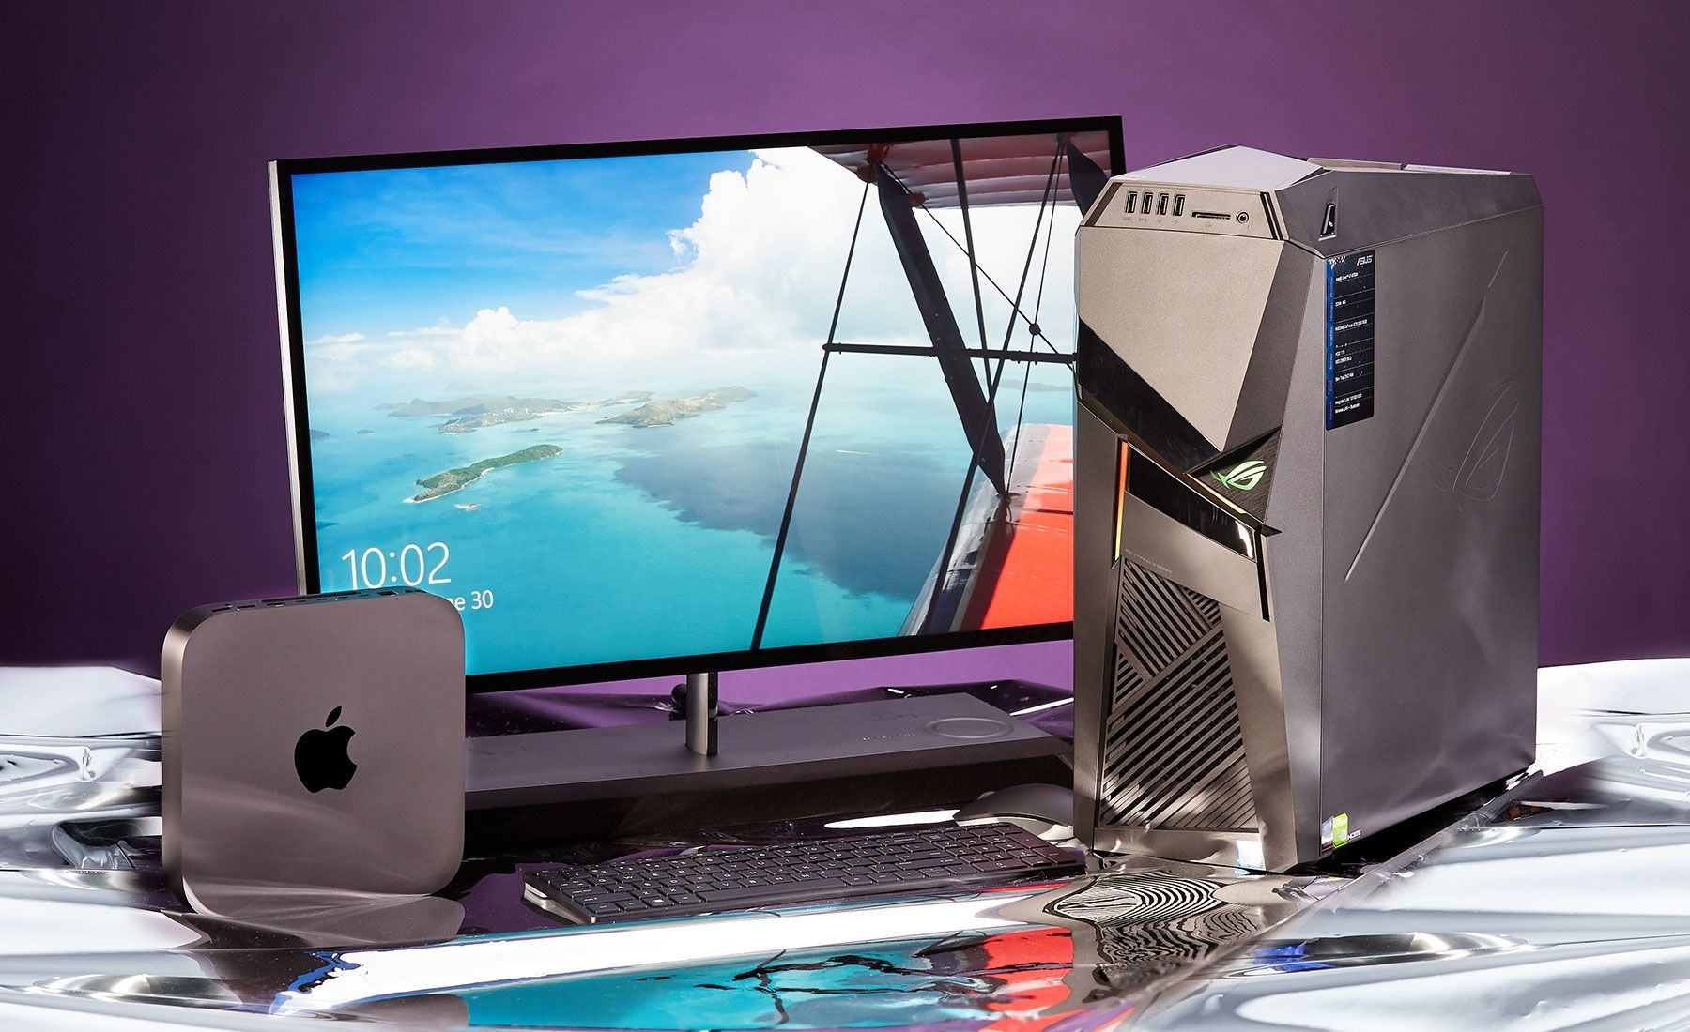
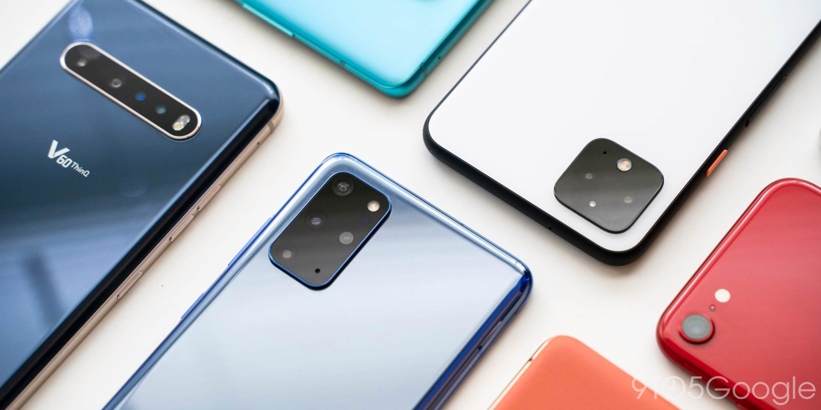
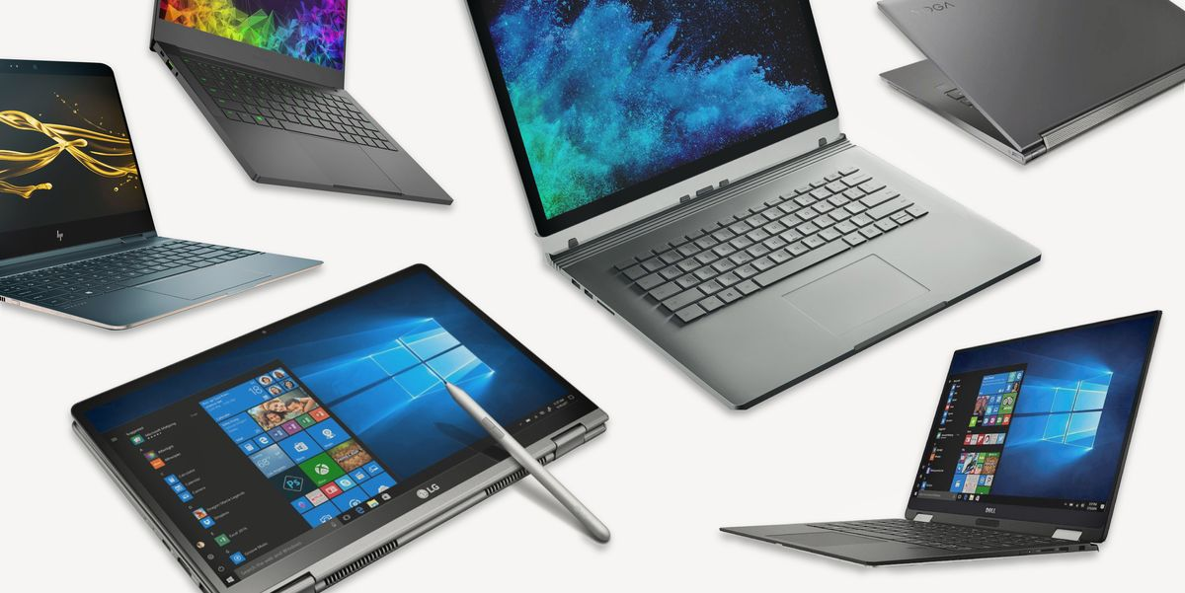
Computer Types
There are many shapes and sizes
Serve many different purposes
Cost can vary widely
Notes:
There are a myriad of different kinds of computers out there. No matter who you are, there’s something for you. Spend your day in one spot at the office? You could use a desktop. Are you highly mobile with a passion for creativity? You could use a 2-in-1 notebook. Are you thinking about getting something for social experiences with a slight bit of gaming in mind? You should look into a smart phone!
Since we could not possibly explain all the types of computers out there, lets go through the common ones for largest to smallest. First we have a desktop towers. Unlike what the name suggests, these aren’t actually all that huge. The tower part is derived from the shape, and in all reality would likely only take up about half the height of your sitting desk. Towers are all about raw power with a mobility compromise. You will commonly see these in offices where you would realistically need a computer with some serious hardware with high performance. Another use for these devices is videogames. Videogames are extremely demanding on every part of your system from your graphics card, to the CPU, and even your storage. In order to run modern games at high resolutions like 4K and 60 frames per second or above, you will need some incredible performance. Big performance doesn’t come cheap or small.
Moving smaller we have laptops, notebooks, and 2-in-1’s. These computers fit in bags, are light enough to commute with, and can meet all your creative needs. Since these are physically smaller than desktops, they typically don’t have as much computing power or graphical output. This means that they are well suited to serve as your journalistic companion due to their unrivaled mobility, or a great accessory to your photography due to the large and high resolution screen attached. All of these workloads benefit from the mobility, while running your non-intensive workloads just fine. But not all machines in this formfactor are built the same. Some laptops have stronger graphics cards than most 2-in-1’s in order to run light 3D models better, and serve a particular kind of productivity while some 2-in-1’s have a more agile CPU to make the transition from laptop to tablet seamlessly while editing your photos in Adobe Photoshop.
Getting even smaller than that we have Smartphones. These are by far the most popular device given their convenience blended with personal lifestyle. These simply don’t have the horsepower to run applications found on desktops and laptops, but their portability is unrivaled. The integration to your phone carrier such as T-Mobile and Verizon make it an essential for staying connected. The high powered camera on the devices rear and front make it an incredible tool for social media. If you don’t need to run intensive applications, but do need to be constantly on the go, this device is right for you.
https://www.businessinsider.com/laptops-vs-desktops-2018-8
https://www.cs.cmu.edu/~fgandon/lecture/uk1999/computers_types/

Slide 5
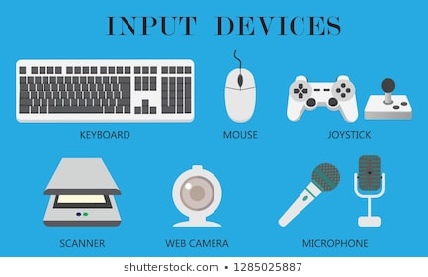
Input devices
The primary way of interacting with your computer.
Highly customizable.
Not many ‘required’.
Notes:
Input devices are essential for interacting with your computer and getting work done. There are an indescribable amount of input devices available today, as well as customization options for each one. Most commonly, you may use a keyboard. You can use these to write text on the screen, as well as issue commands or control media like a movie or a character in a game. This works hand-in-hand with a mouse, which can manipulate a cursor to provide greater accuracy as to a user’s commands. Mice are essential for navigation and organization. If you use a smartphone or laptop, you may commonly use your microphone. This can take the place of a keyboard on some devices but can also commonly be used to dictate text, communicate with others or even issue voice commands through an AI assistant like Google Voice, or Amazon Alexa. Another common input device would be storage media. You can hook up an SD card reader to your computer to edit and store pictures, a DVD drive to watch a movie or install a program, or a hard drive to provide mass storage.
https://smallbusiness.chron.com/input-devices-business-communication-49258.html
https://www.javatpoint.com/input-devices

Slide 6
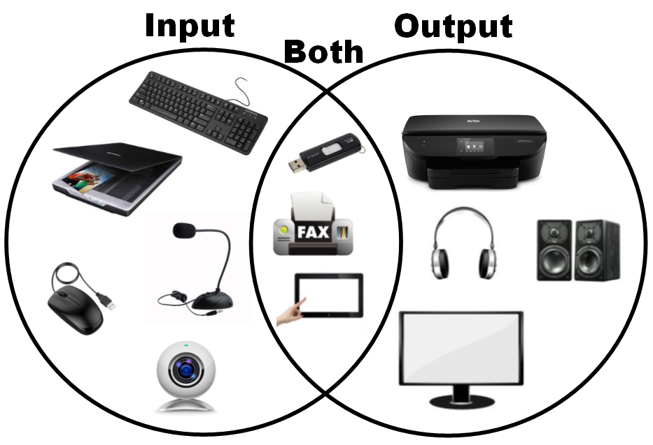
Output devices
Extremely similar to input.
Computers will come with Output.
Many use special ports for various results.
Notes:
Output devices are extremely similar to input devices in that they are a primary way of the user interacting with their device. In this case, the computer is going to be giving you signals. By far the most common output device would be a display. Displays are found from desktops to smartphones, and are essential to tell the user exactly what is happening and when displays can be internally wired in the device like in smartphones or externally wired like desktops. Internal wires are usually connected via a ribbon cable, while there are significantly more options available for external connections. All of this depends on what kinds of ports your computer has as well as what the display comes with. Commonly used today are HDMI or DP connections which enable high resolution displays to output at an incredible refresh rate. More examples of output would be speakers to give the user sound to accompany their setup, or even a printer to take what’s on the screen and get a physical copy of it.
https://turbofuture.com/computers/Computer-Basics-10-Examples-of-Output-Devices
https://www.britannica.com/technology/computer/Output-devices

Slide 7
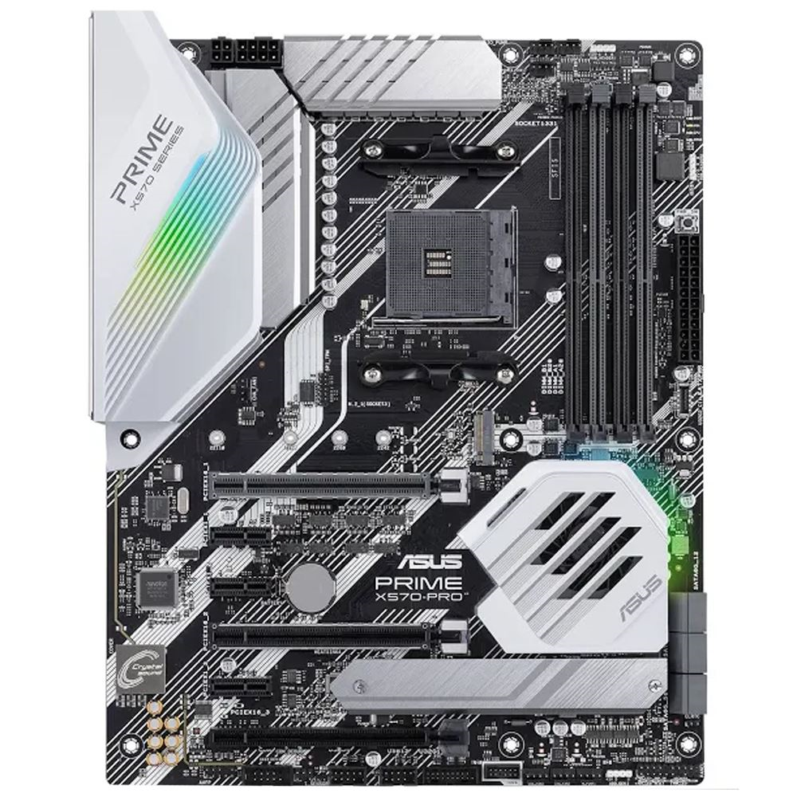
Motherboard
The nervous system of the computer
Controls communication
Provides ports for all hardware
Notes:
If we were relating a computer to body parts, the motherboard would be the nervous system. The motherboard contains hundreds of thousands of circuits etched onto printed circuit board. Each of these circuits sends information to various parts of the computer. Your CPU needs to talk with your GPU. Your RAM needs to talk with your Storage, and reversed. The way all of these things talk with each other is through those channels on your motherboard. Typically, motherboards can vary from model to model, and it gets difficult when picking out which one you need. It’s tough to tell whether your system is going to need PCIE gen 4 support, or if you’re only going to utilize gen 3. It’s tough to tell what CPU socket you are going to use, and if that has upgradability in the future. All of these aspects need to be considered in choosing a motherboard.
https://www.tomshardware.com/reviews/best-motherboards,3984.html
https://www.wepc.com/tips/how-are-motherboards-made-manufacturing/

Slide 8
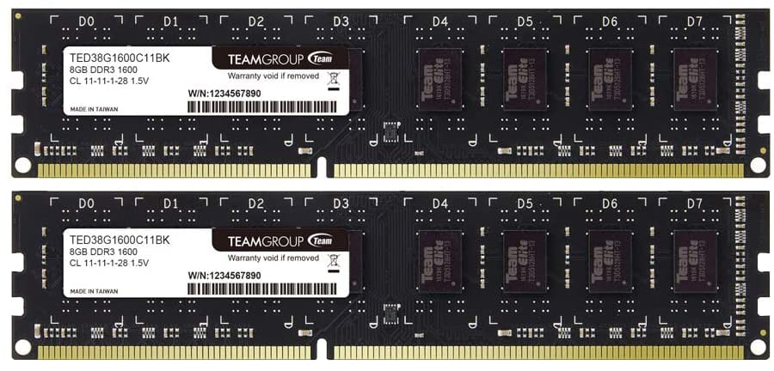
Memory
RAM
Different amounts for different applications
Important to keep computer running smoothly
Notes:
System memory, or also called RAM for Random Access Memory, is an essential component to you computer. It helps you programs run efficiently and effectively. Usually measured in GB or MB, it’s tough to tell how much you need. Should you go all out and get a computer with a whopping 128 GB of RAM? Do you just need 16 GB? Well, that’s a relatively complicated question to answer. You see, It all depends on what you are doing. If you are just running the odd Microsoft Word and sending documents to colleagues, you definitely won’t need as much RAM as a streamer who is looking to play all the latest games at intensely high framerates, or a 3D artist professional who is looking to make Blender their full time career. It is very important to look into not only how you will use your computer, but also what specific applications you will be running since each program requires a specific amount of RAM to function correctly. It is recommended to look through the program specifications that you will commonly be running on your machine in order to properly plan how much you will need.
https://www.crucial.com/articles/about-memory/support-what-does-computer-memory-do
https://www.computerhope.com/jargon/r/ram.htm

Slide 9
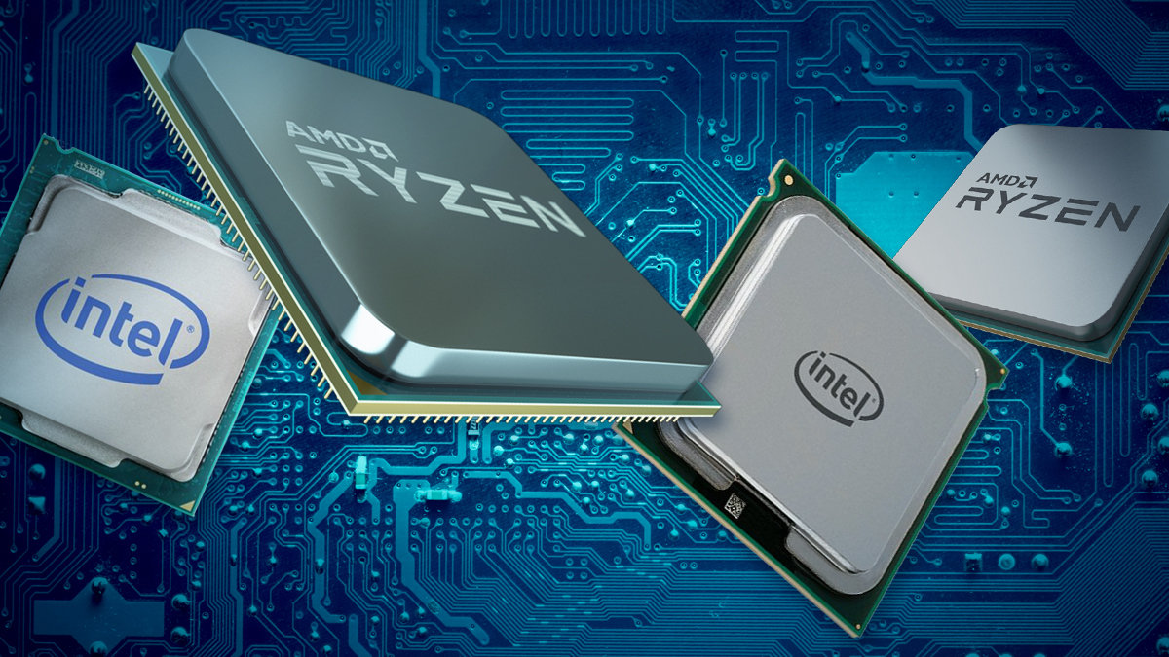
Processor
The Brain of the computer
Heavy computational lifting
Specific Motherboard compatibility
Notes:
The computer Processor is also called the Central Processing Unit, or CPU for short. It is in charge of all the mathematical and logical functions of you computer. It works to process logical code, and perform actions based on it. Choosing a CPU can be one of the most complicated parts of your computer to buy due to the shear number of factors you need to worry about when choosing one. Like most of the parts in your computer, there is no ‘one-cpu-fits-all’ holy grail device. Instead, you need to look at each and every one of your applications to see if they would benefit from having increased logical cores and threads, or a higher base clock (or the GHz number advertised) The frustrating thing is that you could nail down exactly what your going to be doing, but still need rigorous amounts of research to determine your best fit. Despite manufacturer claims, there is no fastest gaming CPU. The new Ryzen series might perform faster than Intel in some games, but Intel will outperform in others. It is all dependent on how each application specifically uses your hardware.
https://www.howtogeek.com/694869/what-is-a-cpu-and-what-does-it-do/
https://store.hp.com/us/en/tech-takes/what-is-processor-speed#:~:text=Basically%2C%20having%20a%20high%20clock,may%20run%20a%20little%20slower.

Slide 10
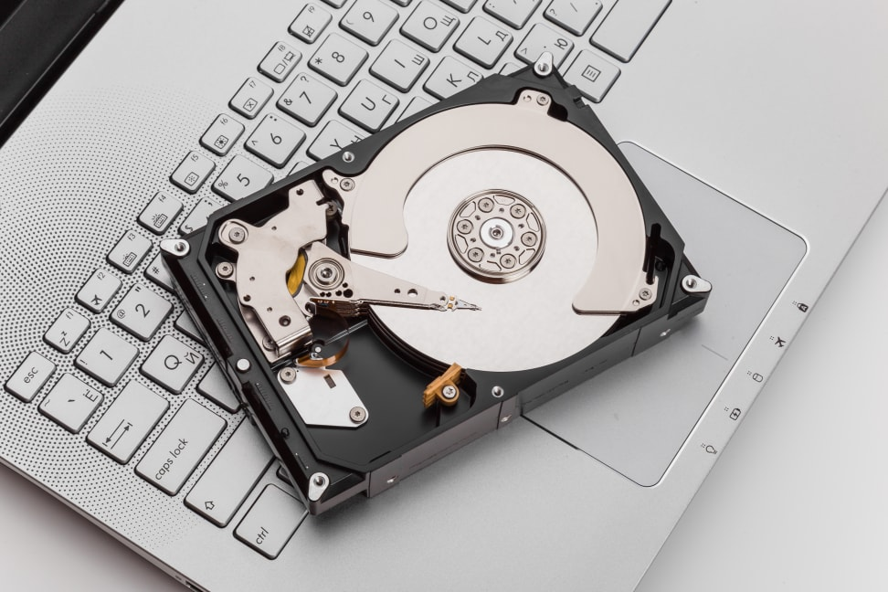
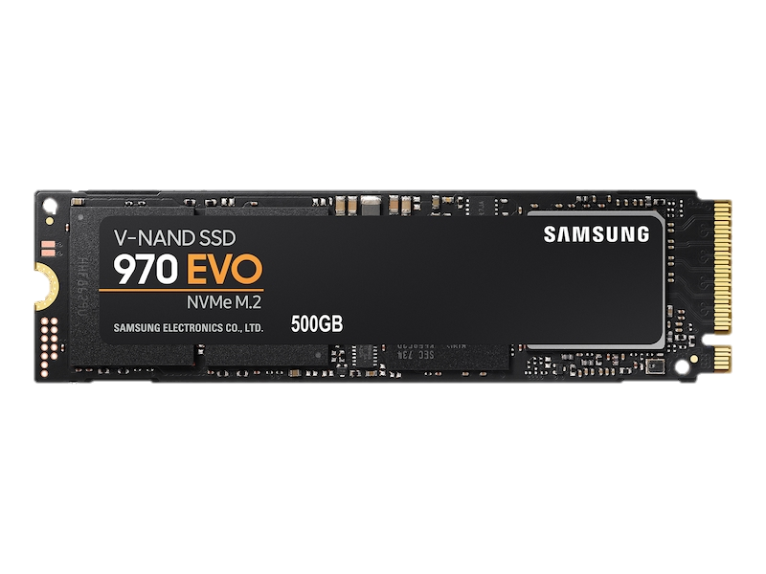
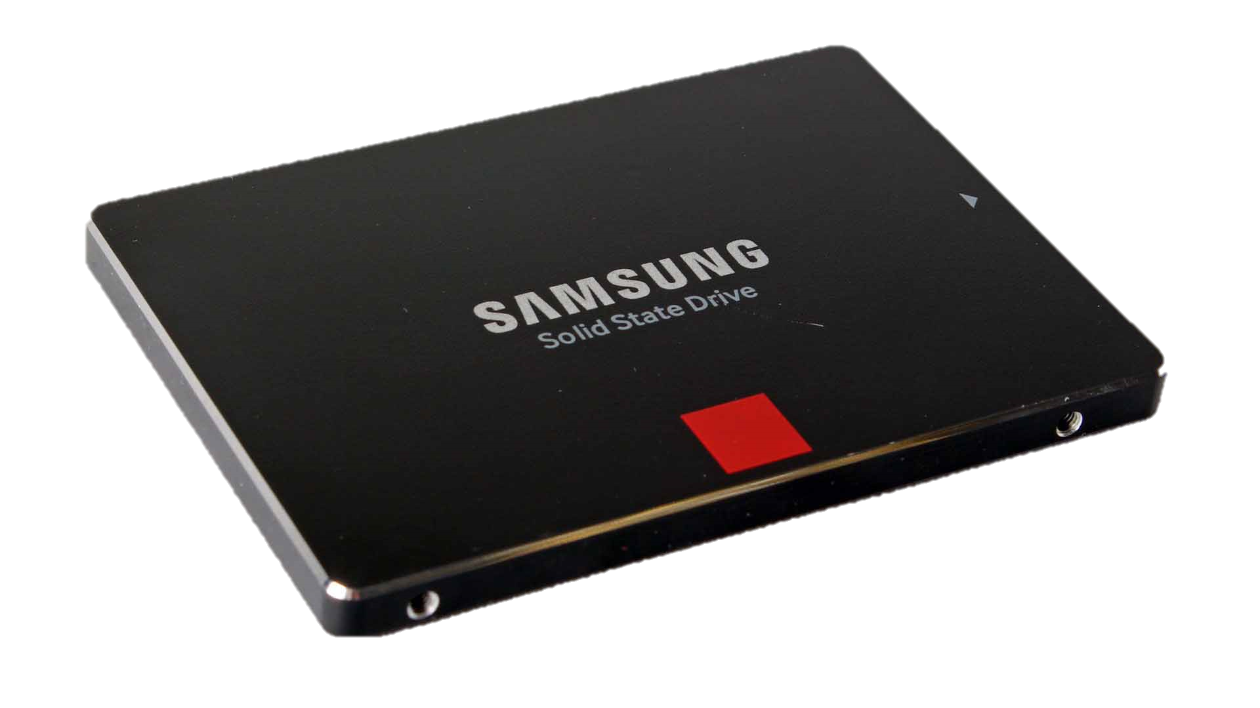
Storage
Comes in all shapes and sizes
Different connectivity
Different speeds
Notes:
Thankfully, storage can be significantly less complicated than one would think going into shopping for computer space. Overall, there are three main types of storage you can get for your computer. Hard drives are more traditional, but they are slowly being replaced by new methods due to their physical insecurities. Because of this, they tend to be a whole lot cheaper for larger storage. Next we have SSD’s. These come in many different shapes, but today we’ll focus on the two main formfactors. SATA drives typically mount inside your case after being hardwired to your motherboard to receive power and transmit data. The smallest formfactor is an M.2 NVMe. These are about the size of a stick of gum and are the fastest storage options available today, but also the most expensive. They plug directly into a slot on your motherboard, and don’t need any wiring for power or data transmission.
https://premioinc.com/blogs/blog/different-types-of-storage-devices-how-to-use-them
https://www.kingston.com/unitedstates/en/community/articledetail/articleid/48543

Slide 11
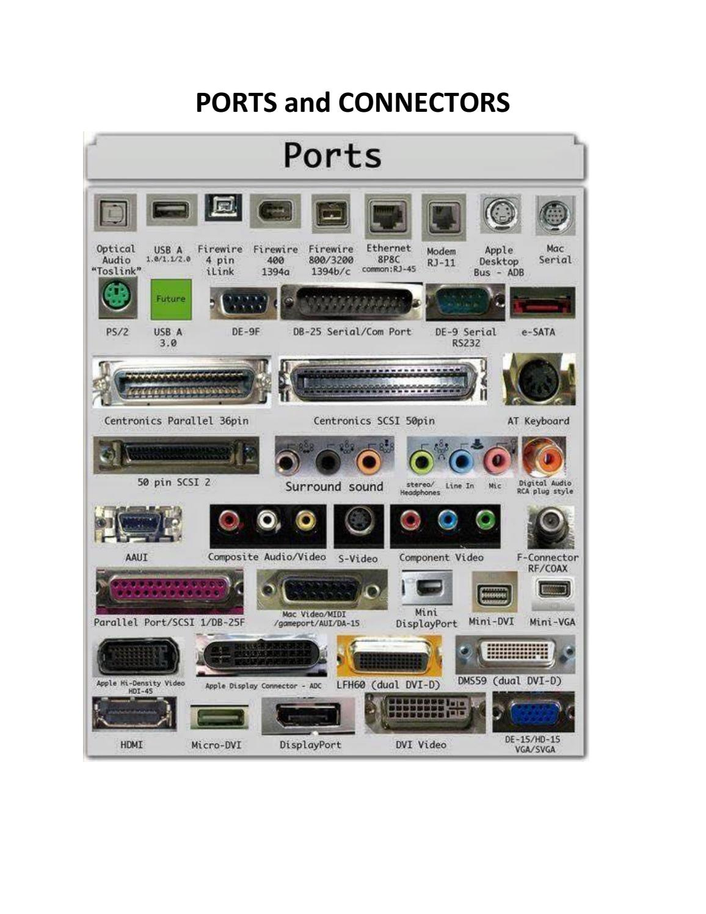
Computer Ports
Controls communication
Input and Output
Internal connections
Provides flexibility
Notes:
There are a whole bunch of ports in one machine, depending on the make. All of these control how your device can communicate with both the internal workings, and peripherals you have attached. On your motherboard you’ll have PCIe ports you can plug a Graphics card into, or a Network card if your motherboard doesn’t support integrated WiFi. You plug all the power and data connections for you storage into specific ports on your computer. Even your CPU technically goes into it’s own dedicated port.
On the back of your computer, you will see many more ports. This could also be located on the sides of laptops and bottoms of phones. These ports let you plug in numerous devices like chargers, keyboards, mice, and speakers to use with your setup. The ports of today provide a wide amount of customizability to your setup, and really help to make your computer personal.
https://www.tutorialspoint.com/computer_fundamentals/computer_ports.htm
https://www.electronicshub.org/types-of-computer-ports/

Slide 12
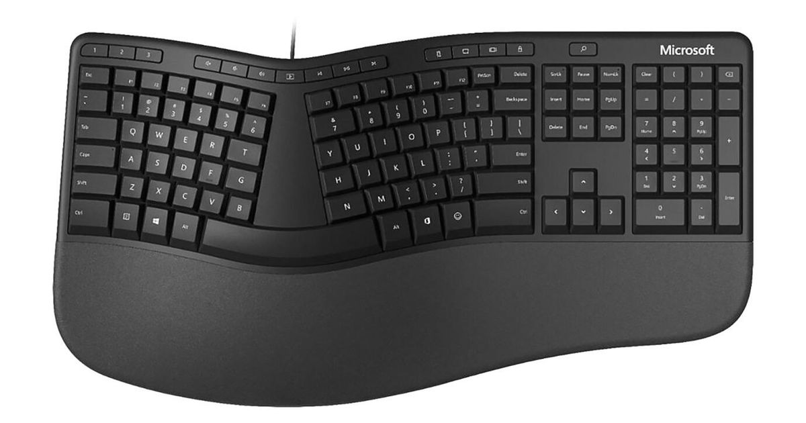
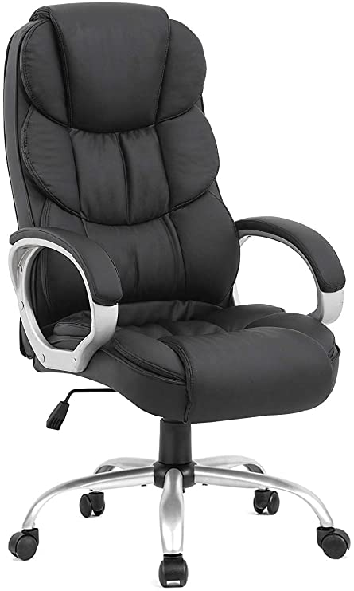

Ergonomics
Comes in nearly every tactile aspect of your device
Improves the haptic experience
Increases accessibility and customization
Notes:
Ergonomics play a huge role in technology today. Many products have been produced to revolutionize how we interact with our computers. Some Keyboards come with padded rests to elevate our wrists while typing. Our chairs are optimized to include lumbar support and arm rests. Even mice sometimes have a single-hand tendency to right or left to provide the most ergonomic experience to fit right into your hand. Your peripherals have come a long way to ensure the way you operate your computer is satisfying, to keep you coming back and to buy new peripherals when yours expire. There’s a lot that goes into ergonomics that you probably don’t realize if you aren’t an enthusiast. For example, The keys on keyboards come equipped with special switches that some manufacturers let you swap out in order to get the perfect clacky experience. You can choose keys that have a little snap at the end when pressing a key to get tactile feedback, or you could get a key that has a smooth motion all the way down, to make it easier to press during those intense rounds of video games where every millisecond seemingly counts.
https://uhs.umich.edu/computerergonomics
https://safetyservices.ucdavis.edu/units/occupational-health/ergonomics/office-computer/chair

